Slide 1
Report by Standing Committee on Engineering for Innovative Technologies
Jing PENG
March, 2022
Notes:
Dear Colleagues, Ladies and Gentleman, Good Morning! Good Afternoon! Good Evening! It is very nice to meet you all online.

Slide 2
About WFEO-CEIT
WFEO Committees and WGs
Members from 32 countries/regions
Hosted by the China Association for Science and Technology (CAST)
Themes: Cloud engineering and Internet plus; Big data; Intelligent technology and robotics; Sensor technology and Internet of Things (IoT); Smart devices and materials
Disaster Risk Management
Engineering for Innovative Technologies
Engineering and the Environment
Energy
Young Engineers / Future Leaders
Education in Engineering
Anti Corruption
Women in Engineering
WFEO-CEIT
Engineering Capacity Building
Information and Communication
Working Group on Water
Working Group on Infrastructure Report Card
WFEO-UN Relations Committee
Notes:
The Committee on Engineering for Innovative Technologies is hosted by the China Association of Science and Technology since 2015, and now we have members from 32 countries. CEIT has set its objectives in the area of technological advancements to identify and promote suitable technologies for sustainable development, especially in the context of the UN Sustainable Development Goals and the relevant agenda.

Slide 3
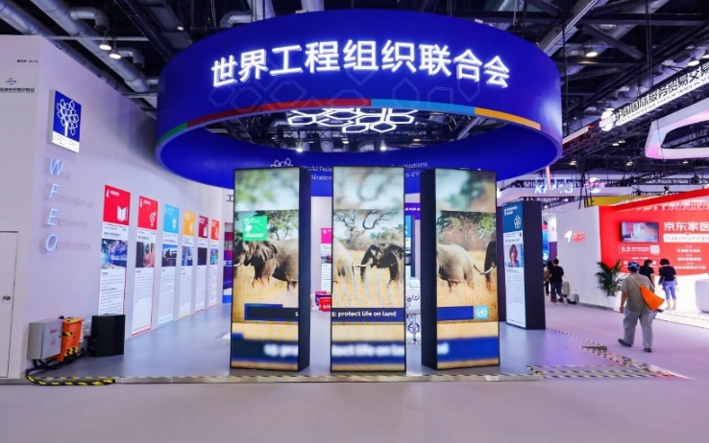
Activity Review in 2021
Support the 2nd WED
Webinar on Poverty Alleviation
Young Engineers Leading the Way: Video Campaign
Online Open Course on Innovative Technologies for Sustainable Development
Participate in 2021 China International Fair for Trade in Services (CIFTIS)
Notes:
During the past two years, we have witnessed how the whole world has been severely affected by the epidemic, and how Artificial Intelligence and other innovative technologies can help the world recover. CEIT continues to move forward during this challenging time. In 2021, we actively participate in and support the 2nd world engineering day, we held the Webinar on Poverty Alleviation, hosted the Video Campaign of Young Engineers Leading the Way, launched the Online Open Course on Innovative Technologies for Sustainable Development and we have done a lot more in promoting engineering innovations and delivering SDGs in line with WFEO’s strategy.

Slide 4
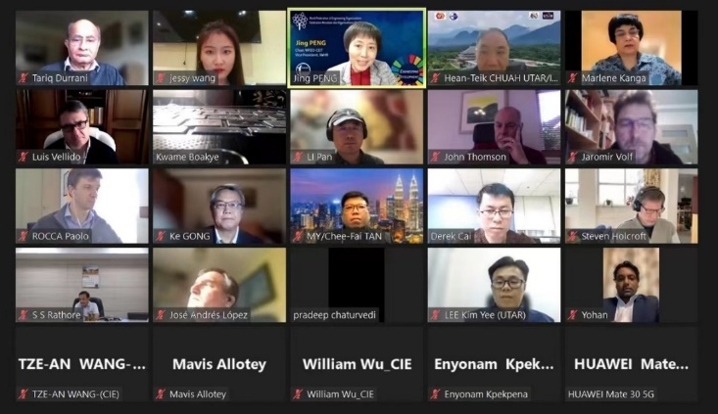
Plan of Actions in 2022
Membership Building
Update the contact information of CEIT members and keep daily contact.
Release two newsletters, including CEIT activities reports, research papers, upcoming events reports, etc.
Organize 2 work meetings (February and October).
2022 CEIT Annual Meeting
Notes:
And for this year, the first and very important thing we are about to do is Membership Building. We will update the contact information of CEIT members and keep daily contact with our members. And we will release two newsletters and organize at least 2 work meetings.

Slide 5
Plan of Actions in 2022
Webinar
Webinar on
Build Back Wiser: Engineering a Sustainable, Inclusive and Green Future with Ethical AI
March 17, 2022
To celebrate the World Engineering Day for Sustainable Development 2022 themed on "Build Back Wiser: Engineering the Future", this webinar convenes engineers, policymakers, researchers, educators etc.
to discuss ethical issues and challenges, engineers' roles and responsibilities while conducting AI innovations and applications,
to showcase model examples of ethical AI applications contributing to building back wiser and delivering SDGs,
to raise the awareness of ethics among engineering community,
to promote the implementation of the Recommendations and the Principles.
Notes:
Also this year, we will launch several Activities. The first one is the webinar on Build Back Wiser: Engineering a Sustainable, Inclusive and Green Future with Ethical AI, which is going to be held on March 17th. This webinar convenes engineers, policymakers, researchers and educators to discuss ethical issues and challenges, engineers' roles and responsibilities while conducting AI innovations and applications, to showcase model examples of ethical AI applications contributing to building back wiser and delivering SDGs, to raise the awareness of ethics among engineering community, and to promote the implementation of the Recommendations and the Principles

Slide 6
Plan of Actions in 2022
Webinar
Webinar on
Engineering Innovations in Poverty Alleviation
October 17, 2022
To celebrate the International Day for the Eradication of Poverty, CEIT plans to hold the webinar on Engineering Innovations in Poverty Alleviation, aiming to facilitate the discussion on the indispensable role of engineering and engineering innovations in poverty alleviation. This Webinar will highlight on the below:
To share successful engineering innovation cases and experiences in poverty alleviation from different countries;
To present key challenges and issues of engineering innovations in poverty alleviation;
To discuss the ways to promote engineering innovations in poverty alleviation.
Notes:
The second event is the webinar on Engineering Innovations in Poverty Alleviation. We plan to hold this webinar on October 17, which is the International Day for the Eradication of Poverty, aiming to facilitate the discussion on the indispensable role of engineering and engineering innovations in poverty alleviation, to share successful engineering innovation cases and experiences in poverty alleviation from different countries; To present key challenges and issues, and To discuss the ways to promote engineering innovations in poverty alleviation.

Slide 7
Plan of Actions in 2022
Call for Innovation Stories
To capture and share the innovative thoughts and activities all around the globe, CEIT will continue the call for Innovation Stories to take a close look at the creativity that we hope could inspire the readers and help better the future.
We highly encourage our members to submit the engineering innovation cases in their own country, and will make them into a casebook showcase on the website.
Notes:
The Call for Innovation Stories was initiated by CEIT in 2019, and we will continue this activity in 2022. We highly encourage our members to submit the engineering innovation cases in their own country and will make them into a casebook showcase on the website.

Slide 8
Plan of Actions in 2022
Strengthen cooperation inside and outside WFEO
Actively participate in International events/meetings to exchange technical ideas & engineering practices and promote the use of innovative technology in engineering.
Cooperate with other WFEO STCs to co-host activates in WFEO.
Cooperate with international/national members in CEIT mission relevant activities.
Notes:
This year we will also make efforts to enhance cooperation inside and outside WFEO, especially by participating in International events/meetings to exchange technical ideas and engineering practices to promote the use of innovative technology in engineering; Cooperating with other WFEO committees to co-host activities in WFEO; Cooperating with international/national members in CEIT mission-relevant activities.

Slide 9
THANK YOU
KEEP IN TOUCH
Contact us:
wfeo-ceit@wfeo.org
Notes:
That is a brief report of what we have done in 2021 and what we plan to do in 2022. We warmly welcome any suggestions and comments and I wish everyone a happy, healthy and prosperous new year!

